Slide 1
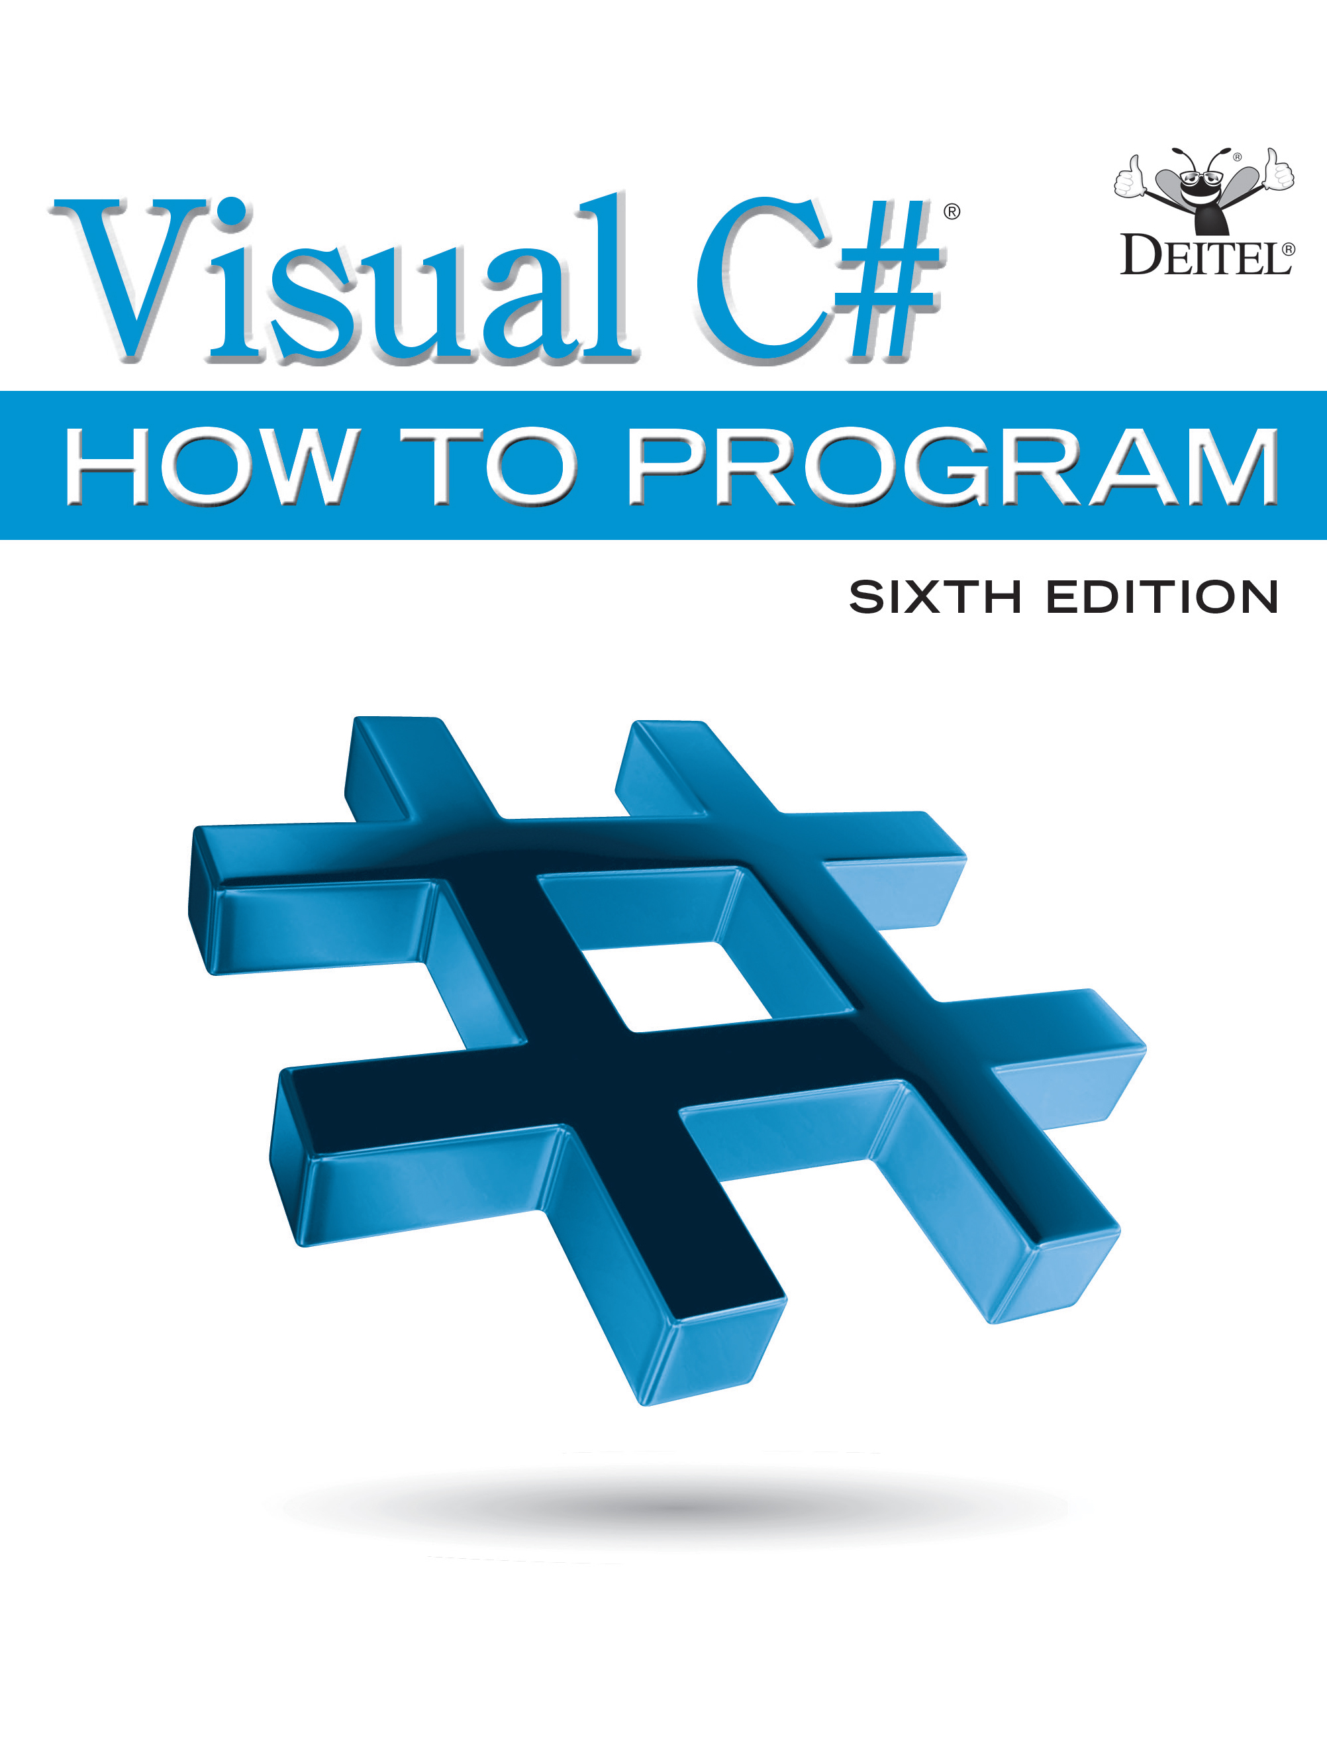
Visual C sharp® How to Program
Sixth Edition
Chapter 4
Introduction to Classes, Objects, Methods and strings
Copyright © 2017 Pearson Education, Inc. All Rights Reserved
Notes:
If this PowerPoint presentation contains mathematical equations, you may need to check that your computer has the following installed:
1) MathType Plugin
2) Math Player (free versions available)
3) NVDA Reader (free versions available)

Slide 2
Learning Objectives (1 of 2)
Begin programming with the object-oriented concepts introduced in Section 1.6.
Declare a class and use it to create an object.
Implement a class's attributes as instance variables and a class's behaviors as methods.
Call an object's methods to make them perform their tasks.
Understand what local variables of a method are and how they differ from instance variables of a class.

Slide 3
Learning Objectives (2 of 2)
Use validation to prevent bad data from being stored in an object.
Understand the software engineering benefits of private instance variables and public access methods.
Use properties to provide a friendlier notation for storing and retrieving data.
Use a constructor to initialize an object's data when the object is created.
Use type decimal for precise monetary amounts and calculations.

Slide 4
Outline (1 of 4)
4.1 Introduction
4.2 Test-Driving an Account Class
4.2.1 Instantiating an Object—Keyword new
4.2.2 Calling Class Account's GetName Method
4.2.3 Inputting a Name from the User
4.2.4 Calling Class Account's SetName Method
4.3 Account Class with an Instance Variable and Set and Get Methods
4.3.1 Account Class Declaration
4.3.2 Keyword class and the Class Body

Slide 5
Outline (2 of 4)
4.3.3 Instance Variable name of Type string
4.3.4 SetName Method
4.3.5 GetName Method
4.3.6 Access Modifiers private and public
4.3.7 Account U M L Class Diagram
4.4 Creating, Compiling and Running a Visual
Project with Two Classes
4.5 Software Engineering with Set and Get Methods

Slide 6
Outline (3 of 4)
4.6 Account Class with a Property Rather Than Set and Get Methods
4.6.1 Class AccountTest Using Account's Name Property
4.6.2 Account Class with an Instance Variable and a Property
4.6.3 Account U M L Class Diagram with a Property
4.7 Auto-Implemented Properties
4.8 Account Class: Initializing Objects with Constructors
4.8.1 Declaring an Account Constructor for Custom Object Initialization

Slide 7
Outline (4 of 4)
4.8.2 Class AccountTest: Initializing Account Objects When They're Created
4.9 Account Class with a Balance; Processing Monetary Amounts
4.9.1 Account Class with a decimal balance Instance Variable
4.9.2 AccountTest Class That Uses Account Objects with Balances
4.10 Wrap-Up

Slide 8
4.1 Introduction
Each class you create becomes a new type you can use to create objects, so
is an extensible programming language.
Major development teams in industry work on applications that contain hundreds, or even thousands, of classes.

Slide 9
4.2 Test-Driving an Account Class (1 of 2)
A person drives a car by telling it what to do (go faster, go slower, turn left, turn right, etc.)—without having to know how the car's internal mechanisms work.
Similarly, a method (such as Main) “drives” an Account object by calling its methods—without having to know how the class's internal mechanisms work.
In this sense, the class containing method Main is referred to as a driver class.

Slide 10
4.2 Test-Driving an Account Class (2 of 2)
To help you prepare for the larger programs you'll encounter later in this book and in industry, we define class AccountTest and its Main method in the file AccountTest.cs (Figure 4.1).
We define the Account class in its own file as well (file Account.cs, Figure 4.2 see slide 21).

Slide 11
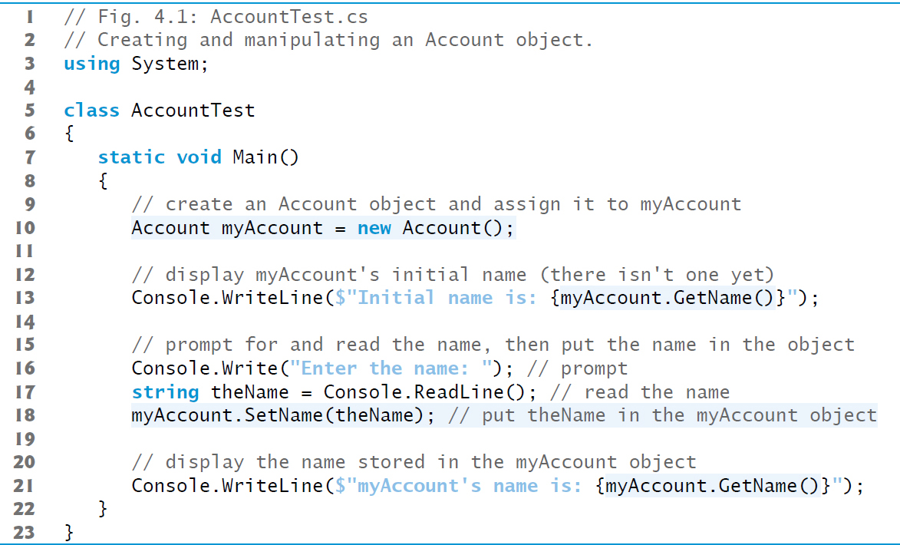
Figure 4.1 Creating and Manipulating an Account Object (1 of 2)

Slide 12
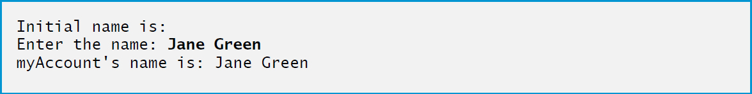
Figure 4.1 Creating and Manipulating an Account Object (2 of 2)

Slide 13
4.2.1 Instantiating an Object—Keyword New
Typically, you cannot call a method of a class until you create an object of that class.
You'll see in Section 10.9 that static methods (and other static class members) are an exception.
Account myAccount = new Account();
Uses an object-creation expression to create an Account object, then assigns it to the variable myAccount. The variable's type is Account.
Keyword new creates a new object of the specified class.

Slide 14
4.2.2 Calling Class Account’s GetName Method (1 of 2)
The Account class's GetName method returns the account name stored in a particular Account object.
To call this method for a specific object, you specify
the object's name (myAccount) followed by
the member access operator (.),
the method name (GetName) and
a set of parentheses.
The empty parentheses indicate that GetName does not require any additional information to perform its task.

Slide 15
4.2.2 Calling Class Account’s GetName Method (2 of 2)
When Main calls the GetName method:
The app transfers execution from the expression myAccount.GetName() (line 13 in Main) to method GetName's declaration (Figure 4.2 see slide 21).
Because GetName was accessed via the object myAccount, GetName knows which object's data to manipulate.
Next, method GetName performs its task—that is, it returns the myAccount object's name to line 13 where the method was called.
Console.WriteLine displays the string returned by GetName—the name is inserted into the interpolated string in place of the call to GetName—then the program continues executing at line 16 in Main.
Because we have not yet stored a name in the myAccount object, line 13 does not display a name.

Slide 16
4.2.3 Inputting a Name from the User
Lines 16–17 prompt for and input a name.
Line 17 uses Console method ReadLine to read the name from the user and assign it to the string variable theName.
Method ReadLine reads a whole line, including all the characters the user types until the newline that the user typed by pressing Enter—the newline is discarded.
Pressing Enter also positions the output cursor to the beginning of the next line in the console window, so the program's next output begins on the line below the user's input.

Slide 17
4.2.4 Calling Class Account’s SetName Method (1 of 2)
Account's SetName method stores (sets) an account name in a particular Account object.
Line 18 calls myAccount's SetName method, passing theName's value as SetName's argument.
put theName in the myAccount object
The method stores this value in the object myAccount.

Slide 18
4.2.4 Calling Class Account’s SetName Method (2 of 2)
When Main calls the SetName method:
The app transfers program execution from line 18 in Main to method SetName's declaration.
Because method SetName was accessed via the myAccount object, SetName “knows” which object to manipulate.
Next, method SetName stores the argument's value in the myAccount object .
When SetName completes execution, program control returns to where method SetName was called (line 18 in Main), then execution continues at line 21.

Slide 19
4.3 Account Class with an Instance Variable and Set and Get Methods
The fact that in we could create and manipulate an Account object without knowing its implementation details is called abstraction.
This is one of the most powerful software-engineering benefits of object-oriented programming.

Slide 20
4.3.1 Account Class Declaration
Class Account (Figure 4.2) contains a name instance variable (line 7) that stores the account holder's name
each Account object has its own copy of the name instance variable.
Class Account also contains method SetName that a program can call to store a name in an Account object, and method GetName that a program can call to obtain the name from an Account object.

Slide 21
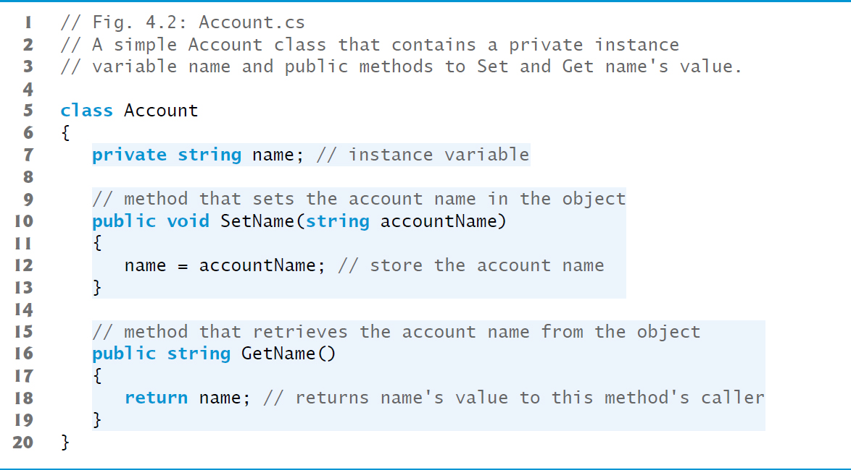
Figure 4.2 A Simple Account Class That Contains a Private Instance Variable Name and Public Methods to Set and Get Name’s Value

Slide 22
4.3.2 Keyword Class and the Class Body
Every class declaration contains the keyword class followed immediately by the class's name.
Each class declaration is typically stored in a file having the same name as the class and ending with the .cs filename extension;
The class's body is enclosed in a pair of braces (lines 6 and 20).
Class, property, method and variable names are all identifiers and by convention all use the naming schemes we discussed in Chapter 3:
class, property and method names begin with an initial uppercase letter (Pascal case)
variable names begin with an initial lowercase letter (camel case).

Slide 23
4.3.3 Instance Variable Name of Type String (1 of 2)
Objects carry their instance variables with them throughout their lifetimes.
Each object has its own copy of the class's instance variables.
A class's methods and properties manipulate the instance variables belonging to particular objects of the class.
Instance variables are declared inside a class declaration but outside the bodies of the class's methods and properties.

Slide 24
4.3.3 Instance Variable Name of Type String (2 of 2)
private string name; // instance variable
declares instance variable name of type string outside the bodies of methods SetName and GetName.
If there are many Account objects, each has its own name.
Because name is an instance variable, it can be manipulated by each of the class's methods and properties.
Clients of class Account—that is, any other code that calls the class's methods (such as class AccountTest's Main)—cannot access the name instance variable because it's declared private.
Clients can access Account's public methods SetName and GetName.
These methods can access private instance variable name.

Slide 25
Good Programming Practice 4.1
We prefer to list a class's instance variables first in the class's body, so that you see the names and types of the variables before they're used in the class's methods and properties. You can list the class's instance variables anywhere in the class outside its method (and property) declarations, but scattering the instance variables can lead to hard-to-read code.

Slide 26
4.3.3 Instance Variable Name of Type String
null—the Default Initial Value for string Variables
Every instance variable has a default initial value—a value provided by
if you do not specify the instance variable's initial value.
Thus, instance variables are not required to be explicitly initialized before they're used in a program
unless they must be initialized to values other than their default values.
The default value for an instance variable of type string is null.
When you use Console.Write or Console.WriteLine to display a string variable that contains the value null, no text is displayed.

Slide 27
4.3.4 SetName Method (1 of 5)
The first line of each method declaration (line 10) is the method header.
The method's return type (which appears to the left of the method's name) specifies the type of data the method returns to its caller after performing its task.
The return type void (line 10) indicates that when SetName completes its task, it does not return (i.e., give back) any information to its calling method—in this example, line 18 of the Main method.

Slide 28
4.3.4 SetName Method (2 of 5)
Parameters represent the data it needs to perform its task.
Method SetName declares the string parameter accountName which receives the name that's passed to SetName as an argument.
When SetName is called the argument value in the call's parentheses is copied into the corresponding parameter (accountName) in the method's header.

Slide 29
4.3.4 SetName Method (3 of 5)
Parameters like accountName are declared in a parameter list located in the required parentheses following the method's name.
Each parameter must specify a type followed by a parameter name.
When there are multiple parameters, they are placed in a comma-separated list.
The number and order of arguments in a method call must match the number and order of parameters in the method declaration's parameter list.

Slide 30
4.3.4 SetName Method (4 of 5)
Every method body is delimited by an opening left brace and a closing right brace.
Within the braces are one or more statements that perform the method's task(s).
When program execution reaches the method's closing brace, the method returns to its caller.

Slide 31
4.3.4 SetName Method (5 of 5)
Variables declared in a particular method's body (such as Main) are local variables which can be used only in that method.
Each method can access only its own local variables, not those of other methods.
When a method terminates, the values of its local variables are lost. A method's parameters also are local variables of the method.

Slide 32
4.3.5 GetName Method
A method that has an empty parameter list does not require additional information to perform its task.
When a method with a return type other than void is called and completes its task, it must return a result to its caller.
The return statement passes the value of its expression back to the caller, which can then use the returned value.

Slide 33
4.3.6 Access Modifiers Private and Public (1 of 2)
The keyword private is an access modifier.
Instance variable name is private to indicate that name is accessible only to class Account's methods
and other members, like properties, as you'll see in subsequent examples
This is known as information hiding.
Most instance variables are declared private.

Slide 34
4.3.6 Access Modifiers Private and Public (2 of 2)
Methods (and other class members) that are declared public are “available to the public.”
They can be used
by methods (and other members) of the class in which they're declared, and
by the class's clients.
In Chapter 11, we'll introduce the protected access modifier.
By default, everything in a class is private, unless you specify otherwise by providing access modifiers.

Slide 35
Error-Prevention Tip 4.1
Making a class's instance variables private and its methods (and as you'll see, properties) public and accessing those instance variables only through the class's methods and properties facilitates debugging, because problems with data manipulations are localized to the methods (and properties).

Slide 36
Common Programming Error 4.1
An attempt by a method that's not a member of a particular class to access a private member of that class is a compilation error.

Slide 37
4.3.7 Account U M L Class Diagram (1 of 5)
U M L diagrams help systems designers specify systems in a concise, graphical, programming-language-independent manner, before programmers implement the systems in specific programming languages.

Slide 38
4.3.7 Account U M L Class Diagram (2 of 5)
In the U M L, each class is modeled in a class diagram as a rectangle with three compartments.
The top compartment contains the class name centered horizontally in boldface type.
The middle compartment contains the class's attribute names, which correspond to the instance variables of the same names in
private in
is represented in the U M L as a minus sign (−) U M L access modifier.
Following an attribute's name are a colon and the attribute type.

Slide 39
4.3.7 Account U M L Class Diagram (3 of 5)
The bottom compartment contains the class's operations, which correspond to the methods of the same names in
The U M L models operations by listing the operation name preceded by a U M L access modifier, for example, + SetName.
This plus sign (+) indicates that SetName is a public operation in the U M L (because it's a public method in

Slide 40
4.3.7 Account U M L Class Diagram (4 of 5)
The U M L indicates an operation's return type by placing a colon and the return type after the parentheses following the operation name.
Method SetName does not return a value (because it returns void in
so the U M L class diagram does not specify a return type after the parentheses of this operation.
The U M L has its own data types similar to those of
— for simplicity, we use the

Slide 41
4.3.7 Account U M L Class Diagram (5 of 5)
The U M L models a parameter by listing the parameter name, followed by a colon and the parameter type in the parentheses after the operation name.

Slide 42

Figure 4.3 U M L class diagram for class Account of Figure 4.2

Slide 43
4.4 Creating, Compiling and Running a Visual C sharp Project with Two Classes
You must compile the classes in Figureure 4.1 and 4.2 before you can execute the app.
The I D E automatically recognizes as the app's entry point the class that contains Main.
When you select Build → Build Solution in Visual Studio, the I D E compiles all the files in the project to create the executable app.
If both classes compile correctly—that is, no compilation errors are displayed—you can then run the app by typing Ctrl + F5.
If you do not build the app before running it, typing Ctrl + F5 will build the app first and run the app only if there are no compilation errors.

Slide 44
Common Programming Error 4.2
In a given project, declaring a Main method in more than exactly one class results in the compilation error, “Program has more than one entry point defined.”

Slide 45
4.5 Software Engineering with Set and Get Methods (1 of 3)
Set and Get methods can validate attempts to modify private data and control how that data is presented to the caller, respectively.
These are compelling software engineering benefits.
If an instance variable were public, any client of the class could see the data and modify it, including setting it to an invalid value.
Also, public data allows client-code programmers to write code that depends on the class's data format.
If the class's owner changes that format, any client code dependent on it would “break” and would need to be adjusted to the new format, making it subject to break again.

Slide 46
4.5 Software Engineering with Set and Get Methods (2 of 3)
Set methods can be programmed to validate their arguments and reject any attempts to Set the data to bad values.
A Get method can present the data in a different form, while the actual data representation remains hidden from the user.
For example, a Grade class might store a grade instance variable as an int between 0 and 100, but a GetGrade method might return a letter grade as a string, such as "A" for grades between 90 and 100, "B" for grades between 80 and 89, …
Tightly controlling the access to and presentation of private data can greatly reduce errors, while increasing the robustness, security and usability of your programs.

Slide 47
4.5 Software Engineering with Set and Get Methods (3 of 3)
Generally, instance variables should be private and methods public.

Slide 48
Software Engineering Observation 4.1
Generally, instance variables should be private and methods public.

Slide 49
Software Engineering Observation 4.2
Change is the rule rather than the exception. You should anticipate that your code will be modified, and possibly often. Using public Set and Get methods to control access to private data makes programs clearer and easier to maintain.

Slide 50
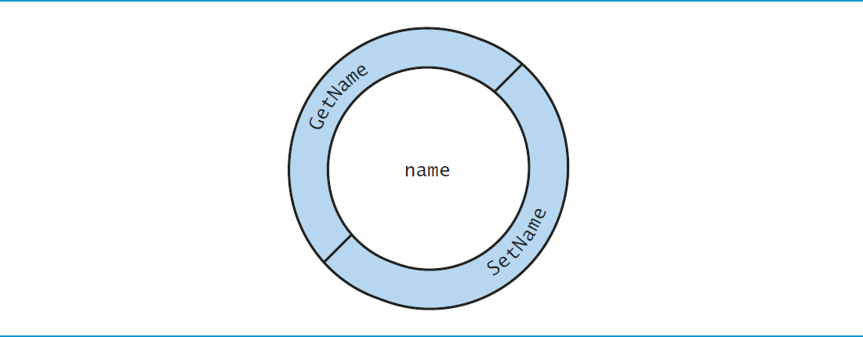
Figure 4.4 Conceptual View of an Account Object with its Private Instance Variable Name and Guarding Layer of Public Methods

Slide 51
4.6 Account Class with a Property Rather Than Set and Get Methods
Our first Account class contained a private instance variable name and public methods SetName and GetName that enabled a client to assign to and retrieve from an Account's name, respectively.
provides a more elegant solution—called properties—to accomplish the same tasks.
A property encapsulates a set accessor for storing a value into a variable and a get accessor for getting the value of a variable.

Slide 52
4.6.1 Class AccountTest Using Account’s Name Property
Figure 4.5 shows the updated AccountTest class that uses class Account's Name property (declared in Figure 4.6 see slide 59) to get and set an Account's name instance variable.

Slide 53
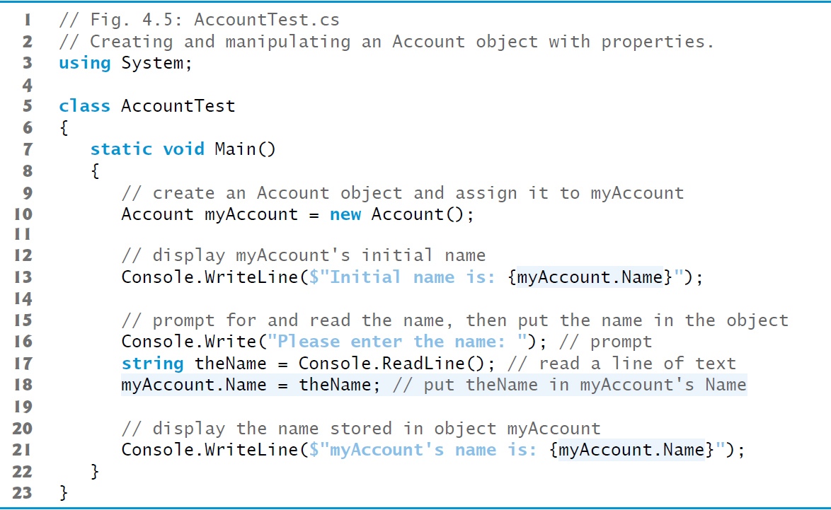
Figure 4.5 Creating and Manipulating an Account Object with Properties (1 of 2)

Slide 54
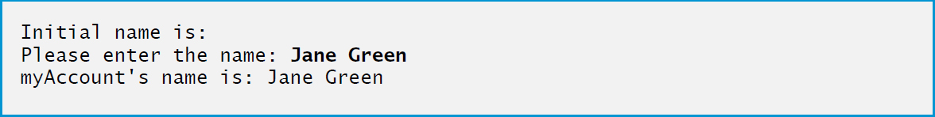
Figure 4.5 Creating and Manipulating an Account Object with Properties (2 of 2)

Slide 55
4.6.1 Class AccountTest Using Account's Name Property (1 of 3)
The get accessor of the Account class's Name property gets the account name stored in a particular Account object.
myAccount.Name
To access a property, you specify the object's name (myAccount), followed by the member-access operator (·) and the property's name (Name).
When used to get the account's name, this notation implicitly executes the property's get accessor, which returns the account's name.

Slide 56
4.6.1 Class AccountTest Using Account's Name Property (2 of 3)
When Main accesses the Name property in line 13
The app transfers execution from the expression myAccount.Name (line 13 in Main) to the property Name's get accessor.
Next, the Name property's get accessor performs its task—that is, it returns (i.e., gives back) the value of myAccount's name instance variable to line 13 where the property was accessed.
Console.WriteLine displays the string returned by the Name property's get accessor.

Slide 57
4.6.1 Class AccountTest Using Account's Name Property (3 of 3)
When property Name is invoked by the expression myAccount.Name on the left of an assignment
The app transfers program execution from line 18 in Main to Name's set accessor.
Property Name's set accessor performs its task—that is, it stores in the myAccount object's name instance variable the string value that was assigned to property Name in Main (line 18).
When Name's set accessor completes execution, program execution returns to where the Name property was accessed (line 18 in Main), then execution continues at line 21.

Slide 58
4.6.2 Account Class with an Instance Variable and a Property (1 of 4)
The updated Account class replaces the GetName and SetName methods from Figure 4.2 with the property Name (lines 10–20 of Figure 4.6).
The property's get and set accessors handle the details of getting and setting data, respectively.
Unlike method names, the accessor names get and set each begin with a lowercase letter.

Slide 59
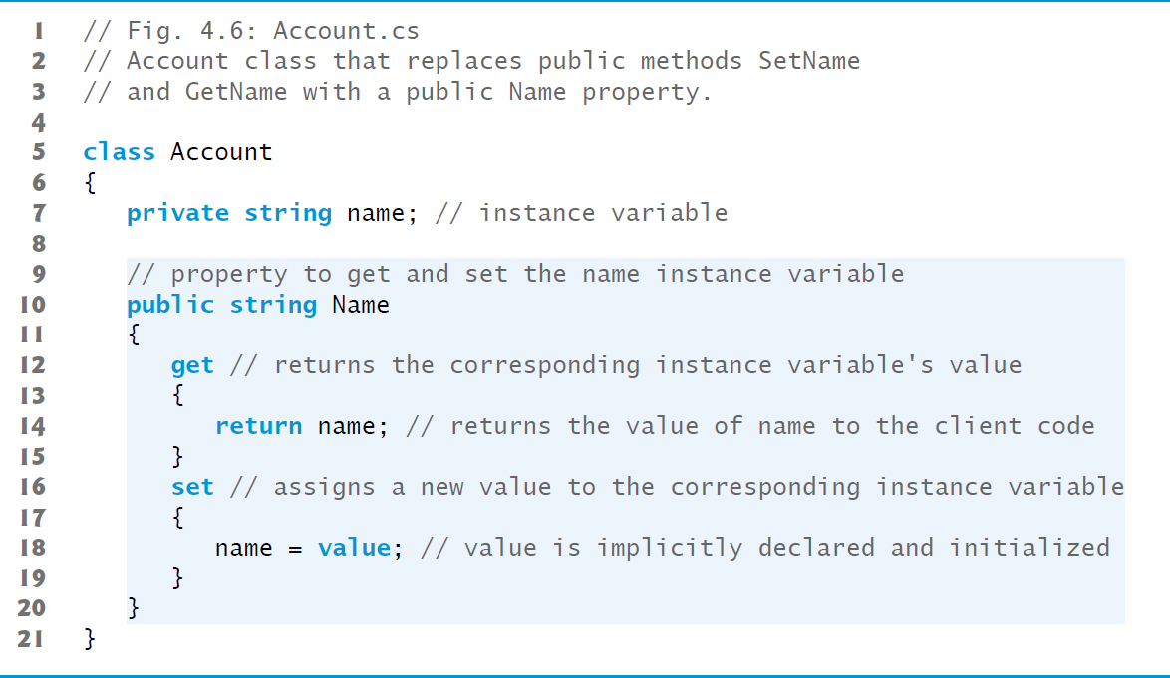
Figure 4.6 Account Class That Replaces Public Methods SetName and GetName with a Public Name Property

Slide 60
4.6.2 Account Class with an Instance Variable and a Property (2 of 4)
public string Name
begins the Name property declaration, which specifies that
the property is public so it can be used by the class's clients,
the property's type is string and
the property's name is Name.
By convention, a property's identifier is the capitalized identifier of the instance variable that it manipulates
is case sensitive, so Name and name are distinct identifiers.
The property's body is enclosed in braces.

Slide 61
4.6.2 Account Class with an Instance Variable and a Property (3 of 4)
A get accessor begins with the keyword get, and its body is delimited by braces
A get accessor’s body contains a return statement that typically returns the value of an instance variable.
The property notation myAccount.Name allows the client to think of the property as the underlying data, but the client still cannot directly manipulate the private instance variable name.
Keyword get is a contextual keyword, because it's a keyword only in a property's context (that is, its body)—in other contexts, get can be used as an identifier.

Slide 62
4.6.2 Account Class with an Instance Variable and a Property (4 of 4)
A set accessor begins with the identifier set followed by its body, which is delimited by braces.
A set accessor uses the keyword value as its parameter.
value is implicitly declared and initialized for you with the value that the client code assigns to the property.
Like get, the keywords set and value are contextual keywords
set is a keyword only in a property's context
value is a keyword only in a set accessor's context

Slide 63
Error-Prevention Tip 4.2
Although contextual keywords, like value in a set accessor, can be used as identifiers in some contexts, we prefer not to do so.

Slide 64
4.6.3 Account U M L Class Diagram with a Property (1 of 2)
properties in the U M L as attributes.
A property is followed by the word “property” in guillemets
We model
Using descriptive words in guillemets (called stereotypes in the U M L) helps distinguish properties from other attributes and operations.
The U M L indicates the type of a property by placing a colon and a type after the property name.

Slide 65
4.6.3 Account U M L Class Diagram with a Property (2 of 2)
A class diagram helps you design a class, so it's not required to show every implementation detail.
Since an instance variable that's manipulated by a property is really an implementation detail of that property, our class diagram does not show the corresponding instance variable.
A programmer implementing the class based on a class diagram would create the instance variables as part of the implementation process.
Similarly, a property's get and set accessors are implementation details, so they're not listed in the U M L diagram.

Slide 66

Figure 4.7 U M L class diagram for class Account of Figure 4.6

Slide 67
4.7 Auto-Implemented Properties (1 of 2)
When a property's get accessor simply returns private instance variable value and its set accessor simply assigns a value to the instance variable you can use an auto-implemented property.
The
compiler automatically creates a hidden private instance variable, and the get and set accessors for getting and setting that hidden instance variable.
This enables you to implement the property trivially, which is handy when you're first designing a class.

Slide 68
4.7 Auto-Implemented Properties (2 of 2)
To use an auto-implemented property in the Account class, you'd replace the private instance variable and the separate property with the following single line of code:

Slide 69
Software Engineering Observation 4.3
In programming languages that do not have property syntax, you think of a class's attributes as instance variables. With
property syntax, you should think of the properties themselves as the class's attributes.

Slide 70
4.8 Account Class: Initializing Objects with Constructors
Each class you declare optionally can provide a constructor with parameters that can be used to initialize an object when it's created.
requires a constructor call for every object that's created, so this is the ideal point to initialize an object's instance variables.

Slide 71
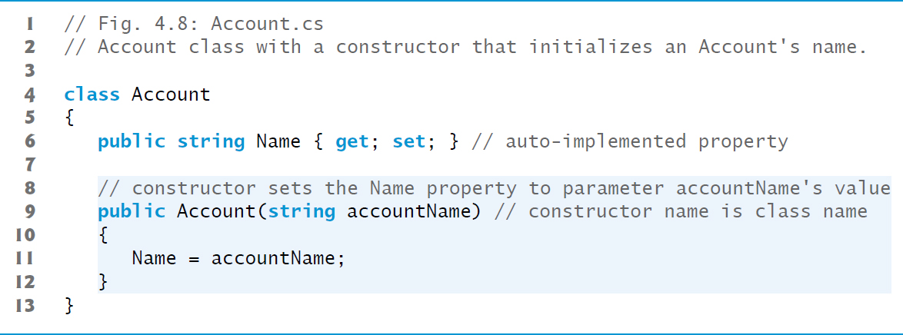
Figure 4.8 Account Class with a Constructor That Initializes an Account’s Name

Slide 72
4.8.1 Declaring an Account Constructor for Custom Object Initialization (1 of 2)
When you declare a class, you can provide your own constructor to specify custom initialization for objects of your class.
Account account1 = new Account("Jane Green");
In this case, the string argument "Jane Green" is passed to the Account object's constructor and used to initialize the Account's name.
A constructor's identifier must be the class's name.
The preceding statement requires an Account constructor that can receive a string.

Slide 73
4.8.1 Declaring an Account Constructor for Custom Object Initialization (2 of 2)
An important difference between constructors and methods is that constructors cannot specify a return type (not even void).
Normally, constructors are declared public so they can be used by the class's client code to initialize objects of the class.
A constructor's body is delimited by a pair of containing one or more statements that perform the constructor's task(s).

Slide 74
4.8.2 Class AccountTest: Initializing Account Objects When They're Created (1 of 3)
Keyword new requests memory from the system to store an object, then implicitly calls the class's constructor to initialize the object.
The call is indicated by the parentheses after the class name.

Slide 75
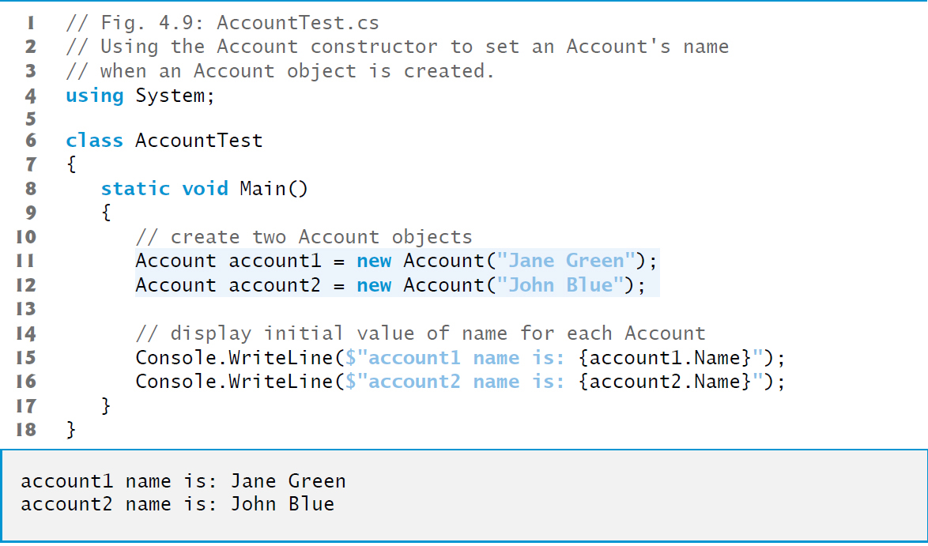
Figure 4.9 Using the Account Constructor to Set an Account's Name When an Account Object is Created

Slide 76
4.8.2 Class AccountTest: Initializing Account Objects When They’re Created (2 of 3)
The empty parentheses in the expression new Account() indicate a call to the class's default constructor
In any class that does not explicitly declare a constructor, the compiler provides a public default constructor (which always has no parameters).
When a class has only the default constructor, the class’s instance variables are initialized to their default values:
0 for numeric simple types,
false for simple type bool and
null for all other types.

Slide 77
4.8.2 Class AccountTest: Initializing Account Objects When They’re Created (3 of 3)
If you declare one or more constructors for a class, the compiler will not create a default constructor for that class.

Slide 78
Software Engineering Observation 4.4
Unless default initialization of your class's instance variables is acceptable, provide a custom constructor to ensure that your instance variables are properly initialized with meaningful values when each new object of your class is created.

Slide 79
4.8.2 Class AccountTest: Initializing Account Objects When They’re Created
The U M L models constructors as operations in the third compartment of a class diagram.
To distinguish a constructor from the class's other operations, the U M L requires that the word “constructor” be enclosed in guillemets
and placed before the constructor's name.
It's customary to list constructors before other operations in the third compartment.

Slide 80

Figure 4.10 U M L Class Diagram for Account Class of Figure 4.8

Slide 81
4.9 Account Class with a Balance; Processing Monetary Amounts
Type decimal is designed to precisely represent numbers with decimal points, especially monetary amounts.

Slide 82
4.9.1 Account Class with a Decimal Balance Instance Variable (1 of 2)
A decimal instance variable is initialized to zero by default.
The Balance property's set accessor performs validation (also known as validity checking).
In 0.0m the letter m (or M) indicates that 0.0 is a decimal literal.
The m is required to indicate a decimal literal.
treats numeric literals with decimal points as type double by default, and doubles and decimals cannot be intermixed.

Slide 83
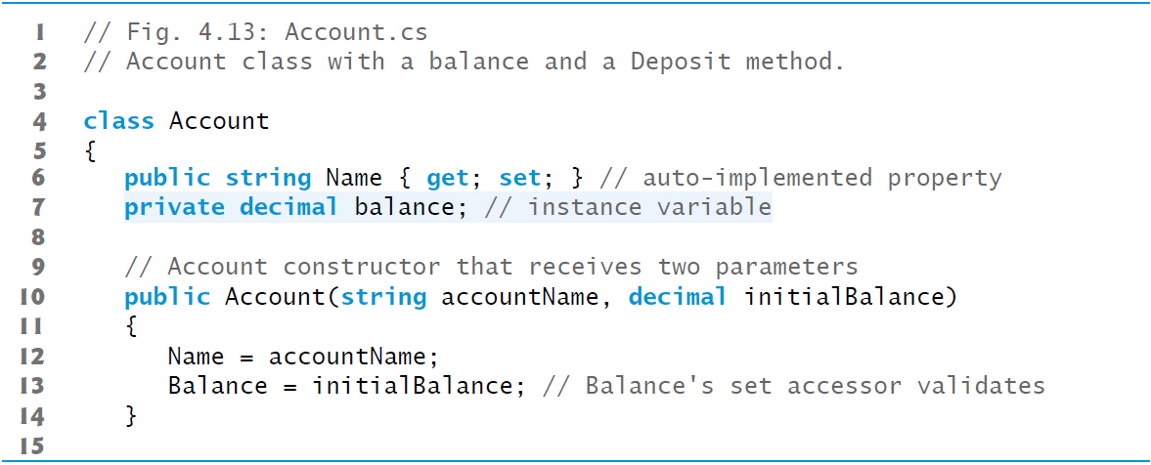
Figure 4.11 Account Class with a Decimal Instance Variable Balance and a Balance Property and Deposit Method That Each Perform Validation (1 of 3)

Slide 84
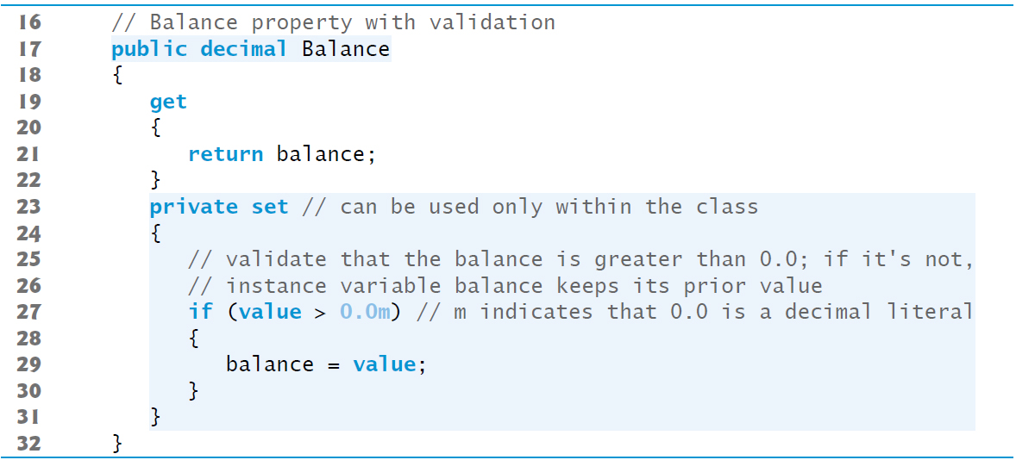
Figure 4.11 Account Class with a Decimal Instance Variable Balance and a Balance Property and Deposit Method That Each Perform Validation (2 of 3)

Slide 85
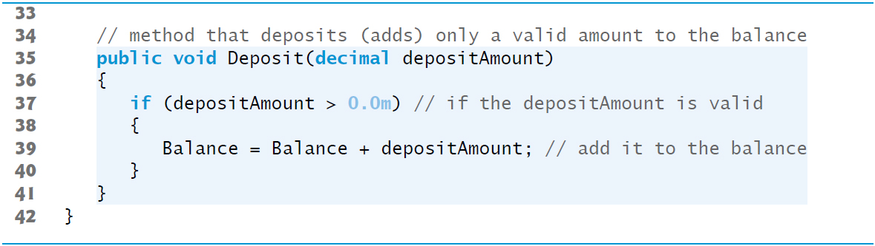
Figure 4.11 Account Class with a Decimal Instance Variable Balance and a Balance Property and Deposit Method That Each Perform Validation (3 of 3)

Slide 86
4.9.1 Account Class with a Decimal Balance Instance Variable (2 of 2)
By default, a property's get and set accessors have the same access as the property—e.g., a public property accessors are public.
It's possible to declare the get and set accessors with different access modifiers.
In this case, one of the accessors must implicitly have the same access as the property and the other must be explicitly declared with a more restrictive access modifier than the property.
We declared the Balance property's set accessor private
indicates that it may be used only in class Account.
enables us to ensure that once an Account object exists, its balance can be modified only by method Deposit

Slide 87
Error-Prevention Tip 4.3
The benefits of data integrity are not automatic simply because instance variables are made private—you must provide appropriate validity checking and report the errors.

Slide 88
Error-Prevention Tip 4.4
set accessors that set the values of private data should verify that the intended new values are proper; if they're not, the set accessors should leave the instance variables unchanged and indicate an error. We demonstrate how to indicate errors by throwing exceptions in Chapter 10.

Slide 89
Software Engineering Observation 4.5
When implementing a method of a class, although it's possible for the method to access the class's instance variables directly, always use the class's properties for that purpose. In Chapter 10, we'll take a deeper look at this issue.

Slide 90
4.9.2 AccountTest Class That Uses Account Objects with Balances (1 of 2)
You can specify formatting in a
6 string interpolation expression by following the value in the braces with a colon and a format specifier.
{account1.Balance:C}
uses the format specifier C to format account1.Balance as currency.
The Windows culture settings on the user's machine determine the format for displaying currency amounts, such as the commas vs. periods for separating thousands, millions, etc.

Slide 91
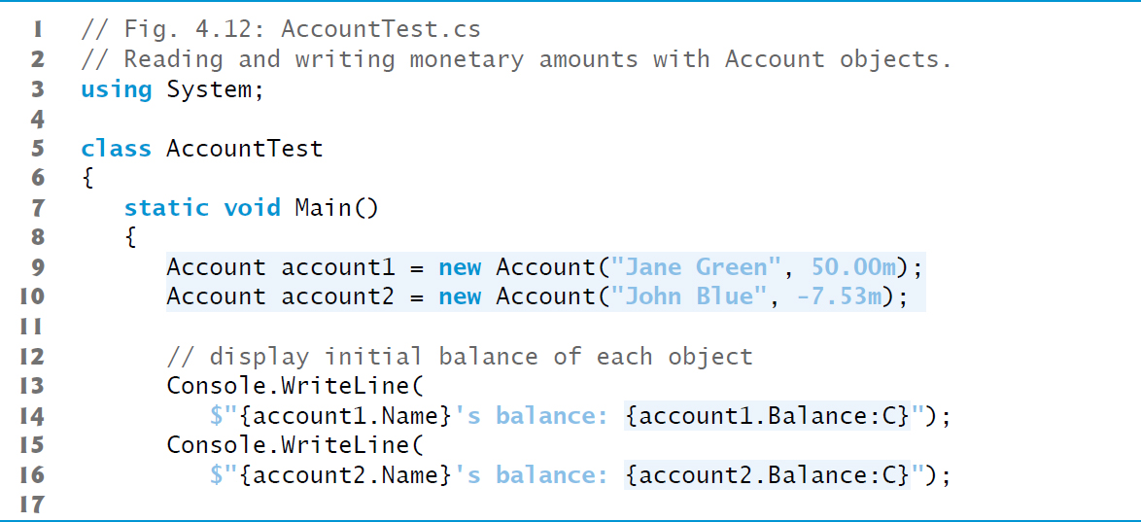
Figure 4.12 Reading and Writing Monetary Amounts with Account Objects (1 of 4)

Slide 92
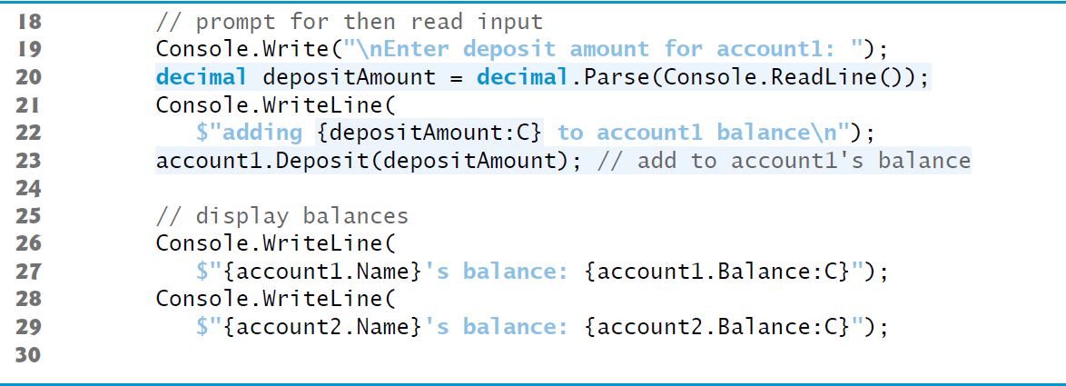
Figure 4.12 Reading and Writing Monetary Amounts with Account Objects (2 of 4)

Slide 93
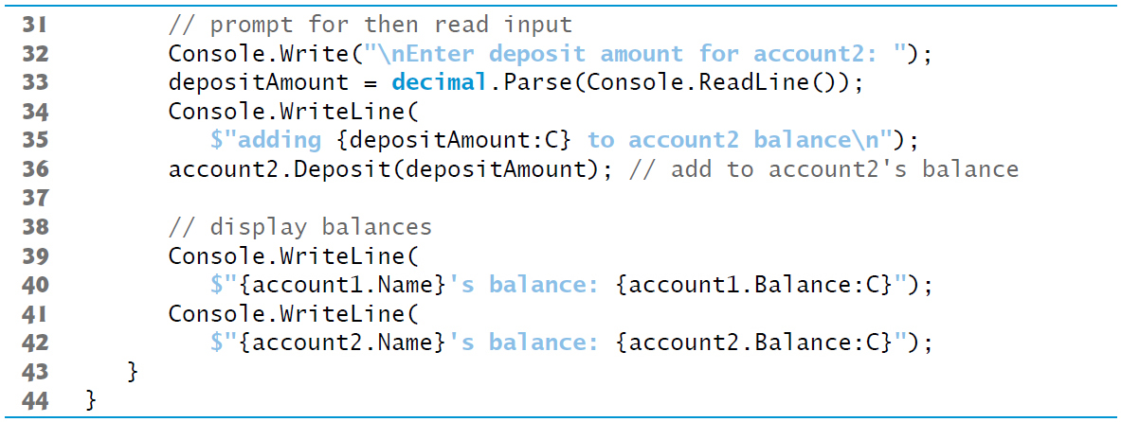
Figure 4.12 Reading and Writing Monetary Amounts with Account Objects (3 of 4)

Slide 94

Figure 4.12 Reading and Writing Monetary Amounts with Account Objects (4 of 4)

Slide 95
Figure 4.13 String Format Specifiers (1 of 2)
Format specifier | Description
C or c | Formats the string as currency. Includes an appropriate currency symbol ($ in the U.S.) next to the number. Separates digits with an appropriate separator character (in the U.S. its a comma between every three digits for thousands, millions, etc.) and sets the number of decimal places to two by default.
D or d | Formats the string as a whole number (integer types only).
N or n | Formats the string with a thousands separator and a default of two decimal places.
E or e | Formats the number using scientific notation with a default of six decimal places.
F or f | Formats the string with a fixed number of decimal places (two by default).

Slide 96
Figure 4.13 String Format Specifiers (2 of 2)
Format specifier | Description
G or g | Formats the number normally with decimal places or using scientific notation, depending on context. If a format item does not contain a format specifier, format G is assumed implicitly.
X or x | Formats the string as hexadecimal (base 16 numbers; we discuss these in the online Number Systems appendix).

Slide 97
4.9.2 AccountTest Class That Uses Account Objects with Balances (2 of 2)
Unlike instance variables, local variables are not initialized by default, so they normally must be initialized explicitly.
decimal's Parse method returns the decimal value in this string—each simple type has a Parse method.

Slide 98
Common Programming Error 4.3
compiler will issue the compilation error "Use of unassigned local variable ‘variableName'" if you attempt to use the value of an uninitialized local variable—in the error message, variableName will be the actual variable name. This helps you avoid dangerous execution-time logic errors. It's always better to get the errors out of your programs at compilation time rather than execution time.

Slide 99
Software Engineering Observation 4.6
Replacing duplicated code with calls to a method that contains one copy of that code can reduce the size of your program and improve its maintainability

Slide 100

Figure 4.14 U M L class diagram for Account class of Figure 4.11

Slide 101

Copyright

